Slide 1





NRI 3.0: Innovations in Integration of Robotics
Integration of Autonomous UAS in Wildland Fire Management
Kickoff Meeting
October 29, 2021
Virtual Meeting

Slide 2


Project Details
Award ID: 2132798
Award Dates: Jan 1, 2022 – December 31, 2025
Funding Origin: National Science Foundation
National Robotics Initiative 3.0; Division Of Computer and Network Systems
Program Officer: Ralph Wachter
Institutions and Senior Personnel
Name | Role | Department | Institution | Contact
Mrinal Kumar | PI | Mechanical and Aerospace Engineering | Ohio State University | kumar.672@osu.edu
Roger Williams | Co-PI | School of Environment and Natural Resources | Ohio State University | williams.1577@osu.edu
Amit Sanyal | Co-PI | Mechanical and Aerospace Engineering | Syracuse University | aksanyal@syr.edu
Greg Guess and Daniel Balser | Senior Personnel | Division of Forestry | Ohio Department of Natural Resources | Greg.Guess@dnr.ohio.gov Daniel.Balser@dnr.ohio.gov

Slide 3
Goals: Overview
Overall Scientific Goal
Integration of autonomous unmanned aerial systems (UAS) into prescribed wildland burn projects.
Key Focus Areas of Research
Science of autonomy in uncertain, unstructured environments
Forest management and ecology with prognostics for wildland burns in the Eastern United States
Multidisciplinary integration: planning, UQ, sensing, control, process modeling
Team Expertise
Mrinal Kumar
UQ in complex systems
Koopman ROM
CC path planning
Evidential sensor fusion
Amit Sanyal
Nonlinear dynamics & control
Robust data-driven control
Application to autonomous aerial vehicles
Roger Williams
℞ fire for Oak forest management
Wildland fire behavior
Forest density management

Slide 4

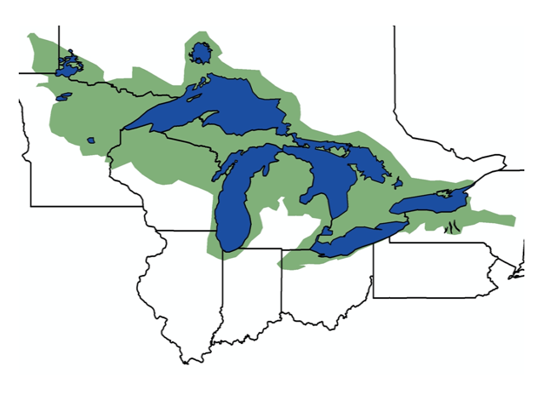

Goals: Overview
Overall Educational Goal
Cross disciplinary education that accentuates a constructive context for autonomous robotics
Key Focus Areas
Classroom, professional development and public outreach material on Robotic Missions in Wildland Fires
Expand student participation in prescribed burns
Foster partnerships: ST-DNR integration, local schools and community colleges, e.g., MECHS@CMH
Educational Material
Partnerships
Forest + fire ecology
Fire weather environment
Prescribed burn design
Axiomatic probability theory
Modeling uncertainty
Evidential information fusion
GN&C of autonomous agents
OH-DNR
Metro Early College High School
Columbus and Syracuse area schools
Lake States Fire Science Consortium
Complementary projects around the nation, e.g., recent LEAP-HI project @NV

Slide 5
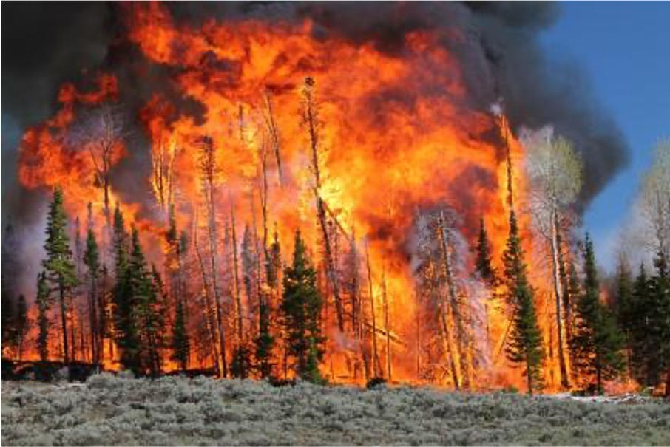
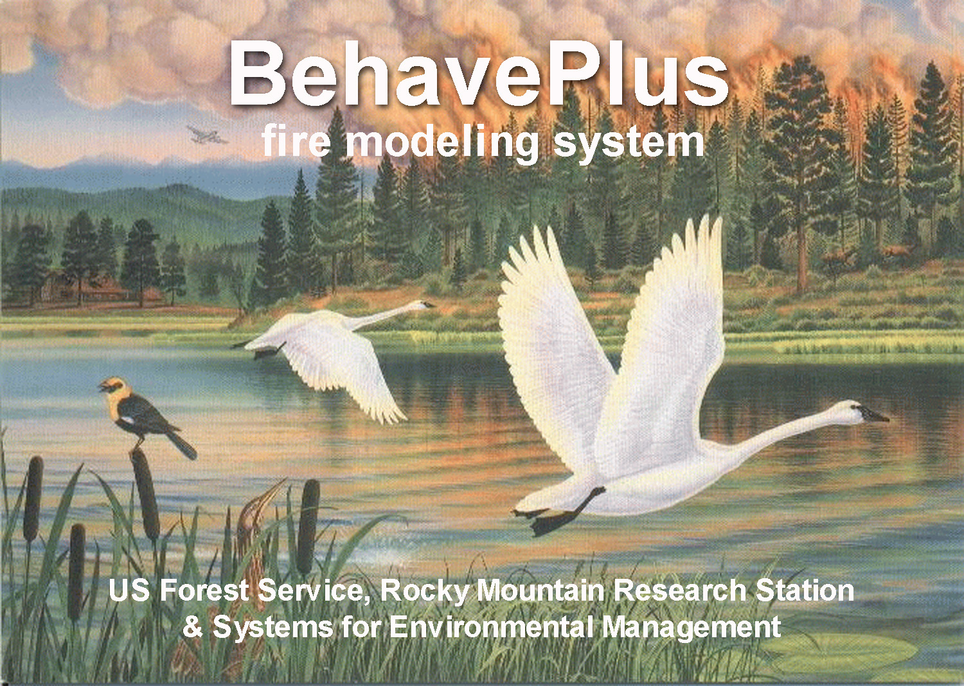
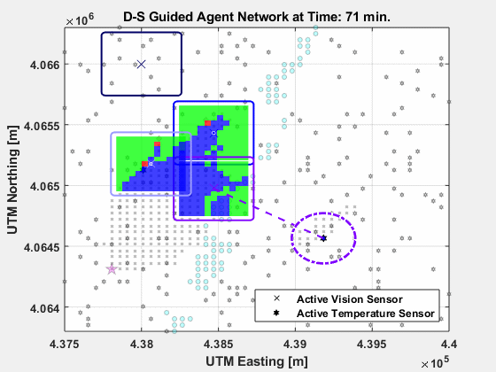
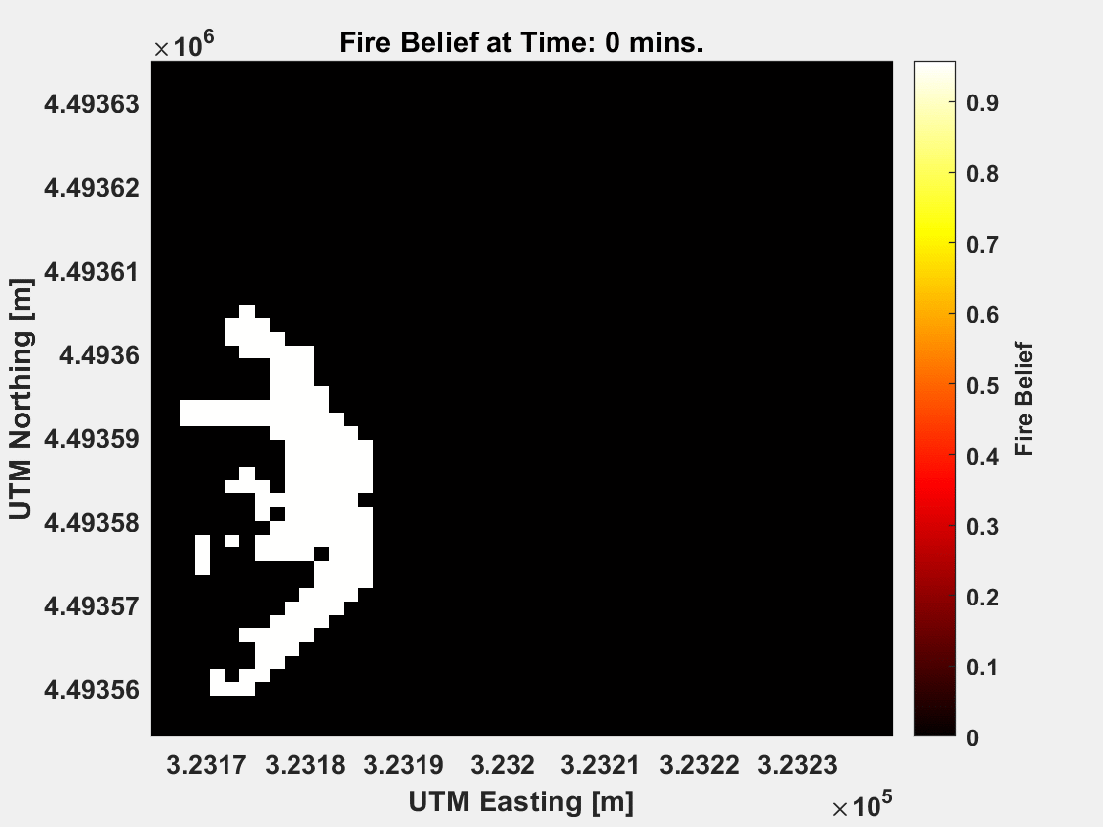
Research Plan: Context
Missions in Unstructured Uncertainty
poor/inadequate models
sensing conflict & anomalies
“broken”, dynamic environment
hazardous for humans, and possibly, materials

Slide 6
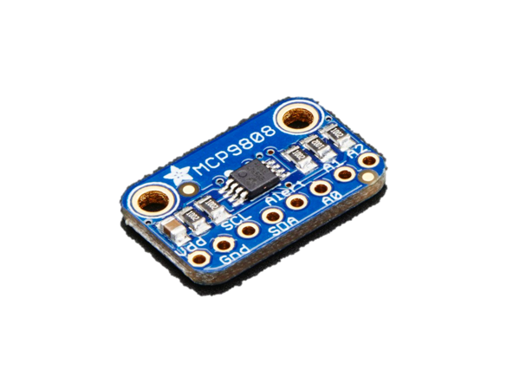
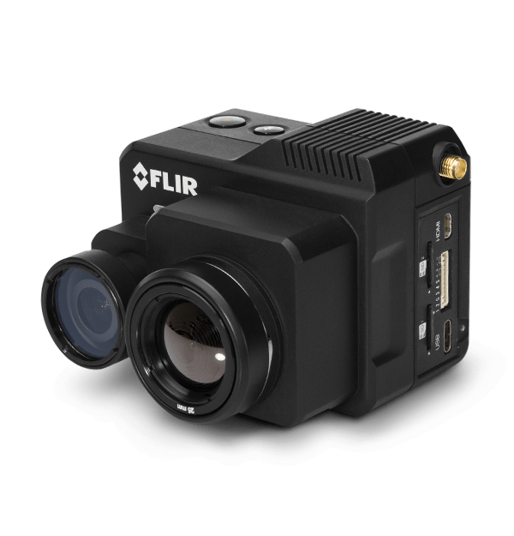
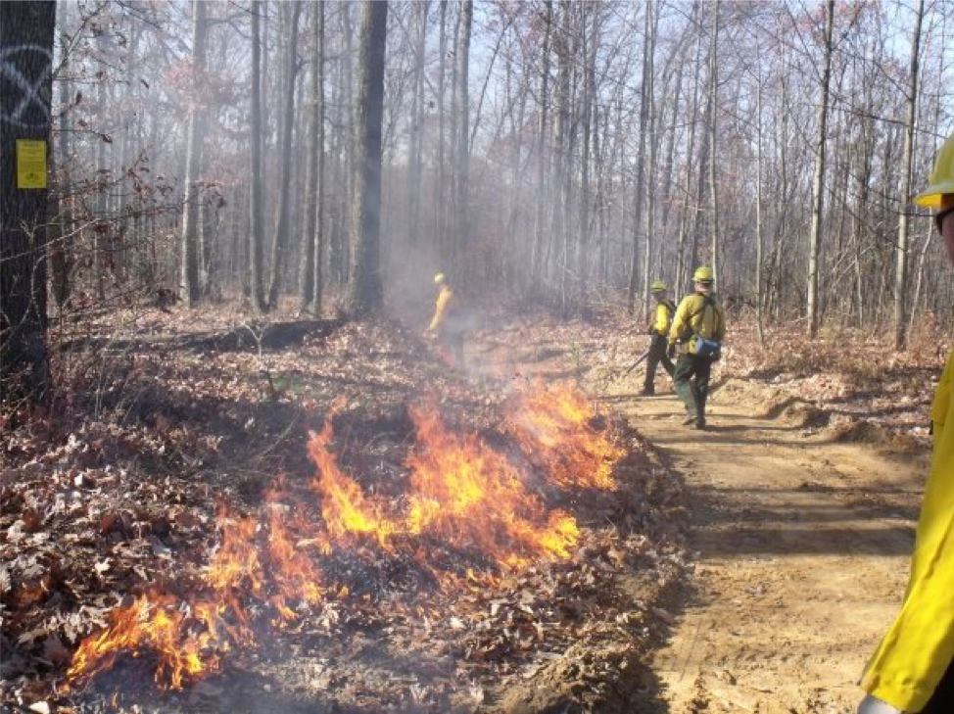
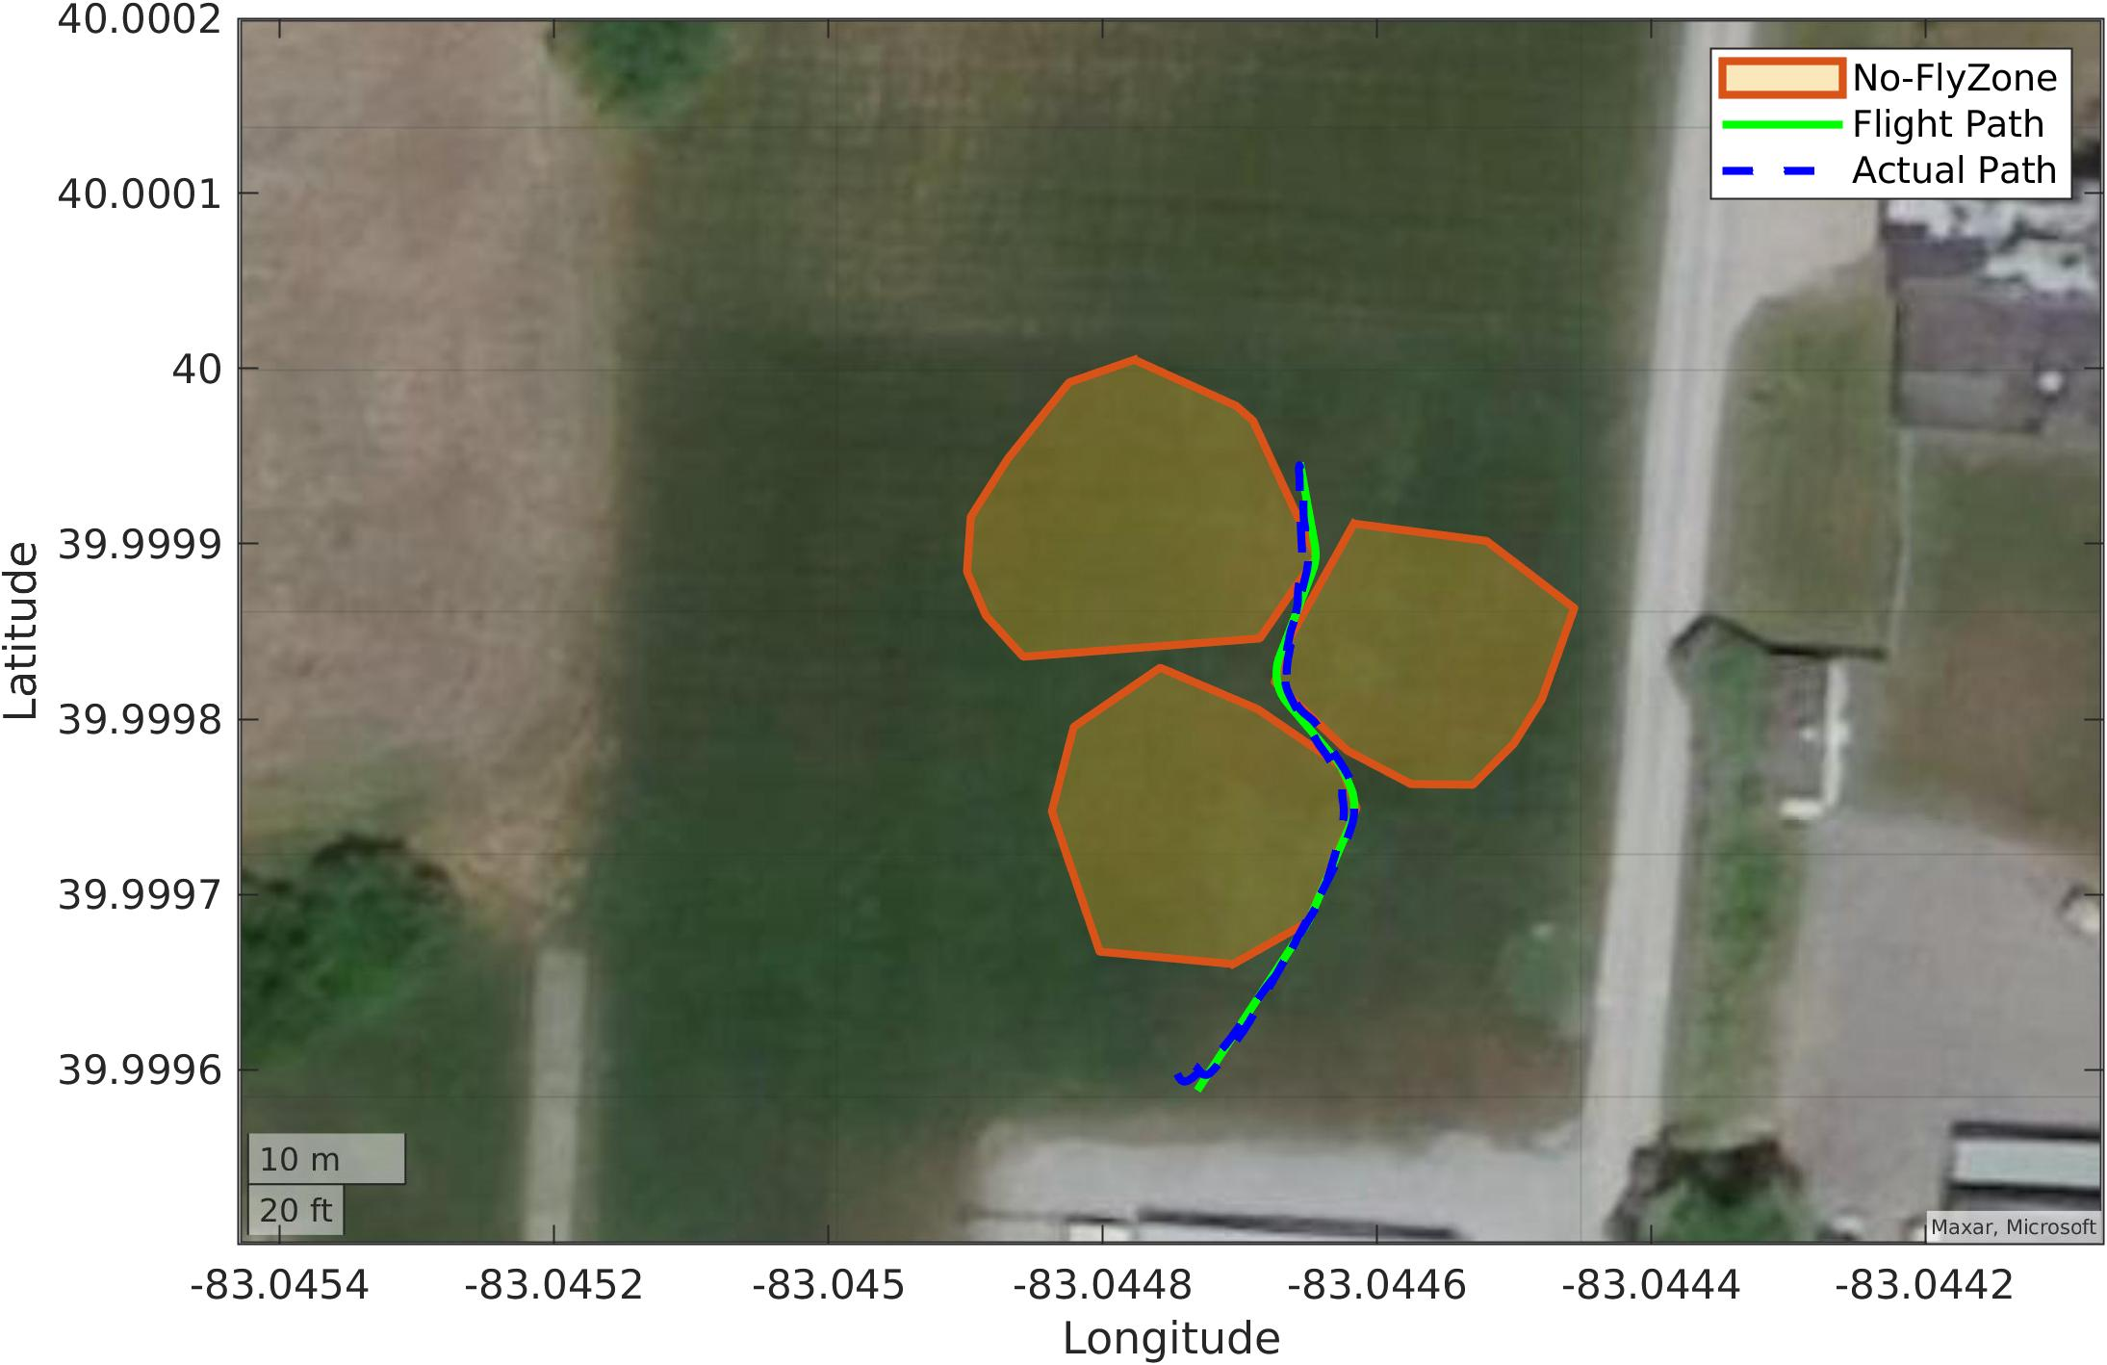
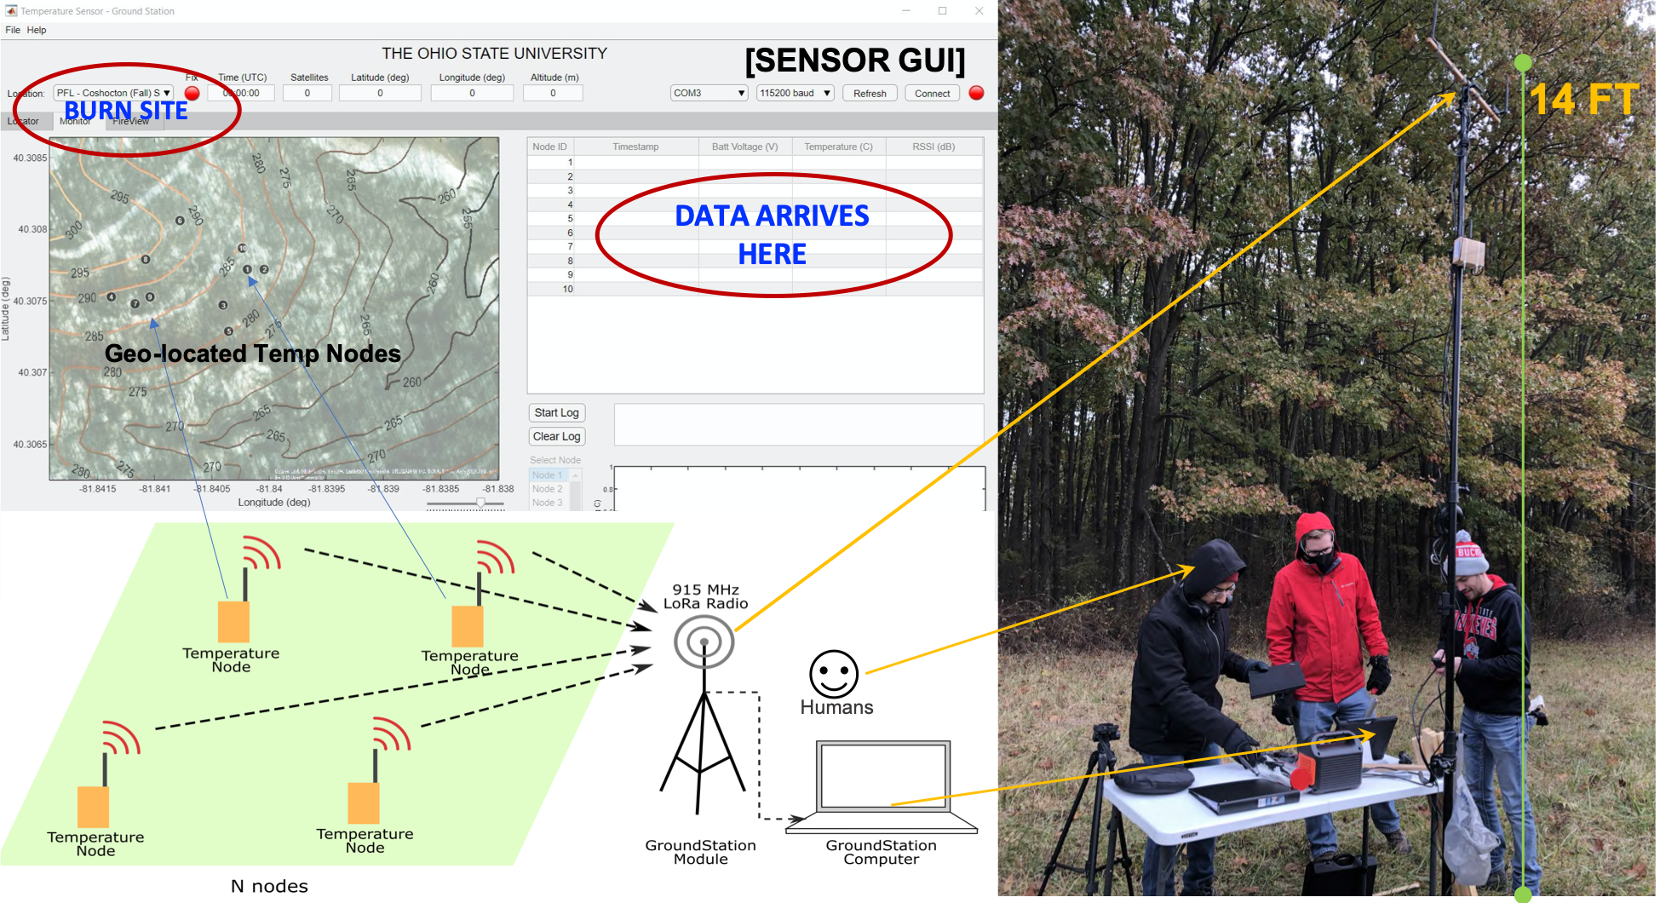
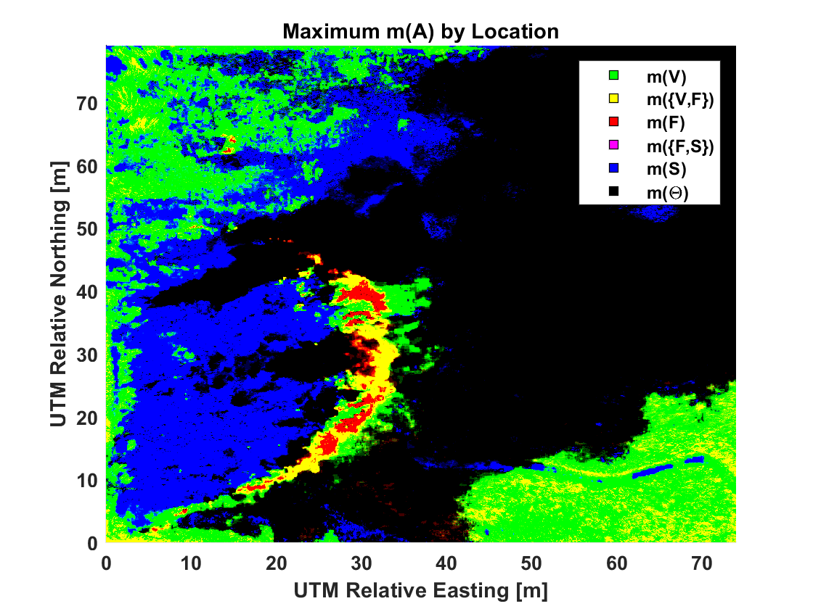
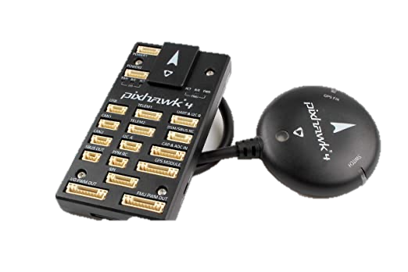
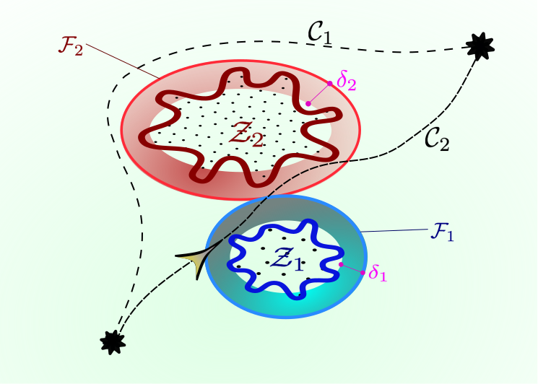
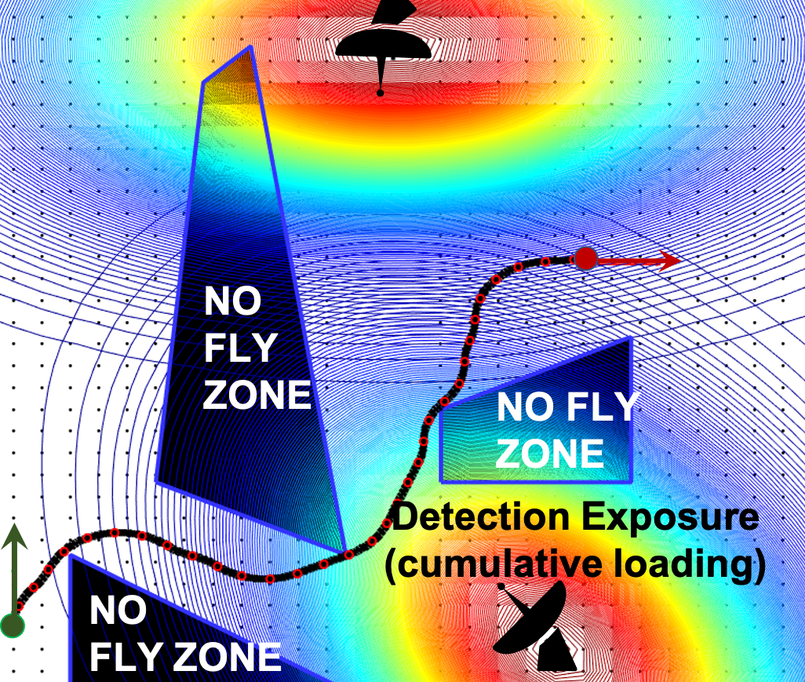
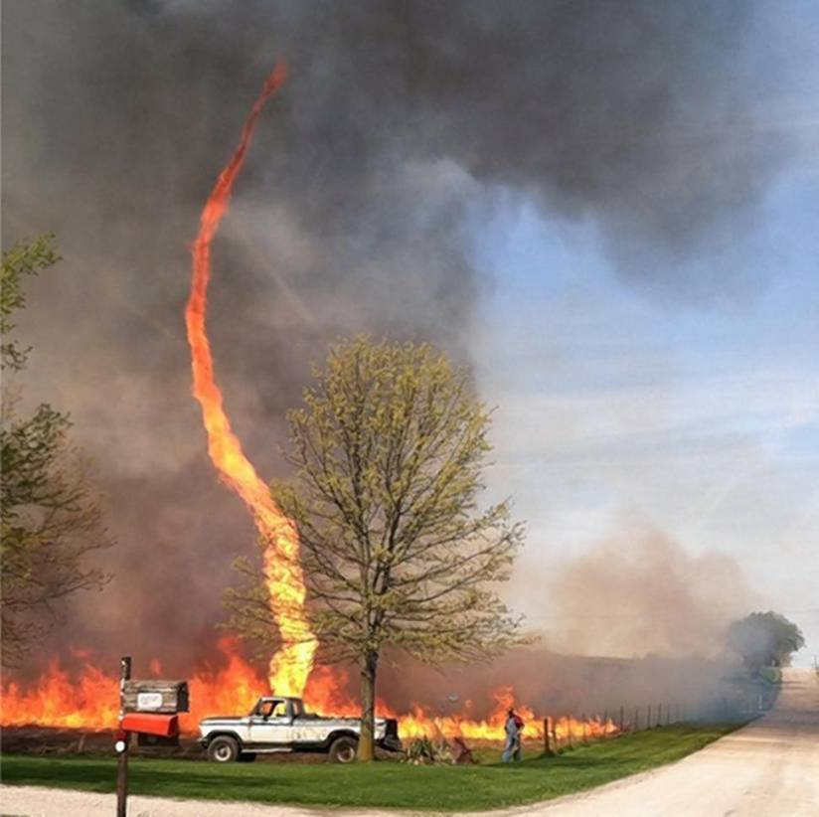
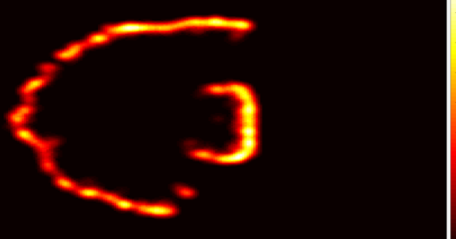
Research Plan: Mission Overview & Integration
Missions in unstructured uncertainty: poor models sensing conflict & anomalies “broken”, dynamic environment
Modeling
Forecasting
Sensing
Field Testing
Communications
Information Fusion
Nav & Control
Path Planning
Situational Awareness

Slide 7
Research Plan: Overview & Integration
MODELING
FLIGHTS
V&V,
INTEGRATION
BURNS
PLANNING
CONTROL
SITUATIONAL
AWARENESS

Slide 8
Research Plan: Areas of Innovation
Environmental Situational Awareness
Local winds
Obstacles and Loads
Path Planning
Evidential Information Fusion
Data-Driven Control
Burn Plan & Fire Modeling
V&V
Systems Integration and Flight Plan

Slide 9
Research : Areas of Innovation
Environmental Situational Awareness
Local winds
Obstacles and Loads
Path Planning: Bryce Ford
Evidential Information Fusion
Data-Driven Control: Amit Sanyal
Burn Plan & Fire Modeling: Greg Guess & Roger Williams
V&V
Systems Integration and Flight Plan

Slide 10

Research Plan: Challenges and Methods (1/3)
MEDIA REMOVED
Environmental Situational Awareness
Local winds
Challenges
Need micro level (< 1 m) resolution;
Local hazards can cause rapid escalation (e.g., firestorm);
Need computationally scalable short-term forecasting
Methods
Combine AWS data (HRRR @ NCEP) with sensor data;
Build ROM using Koopman operator spectral theory;
Observables functions: wind field (speed and direction);
Consider phenomenological (physics-based) loss terms (e.g., conservation principles)

Slide 11
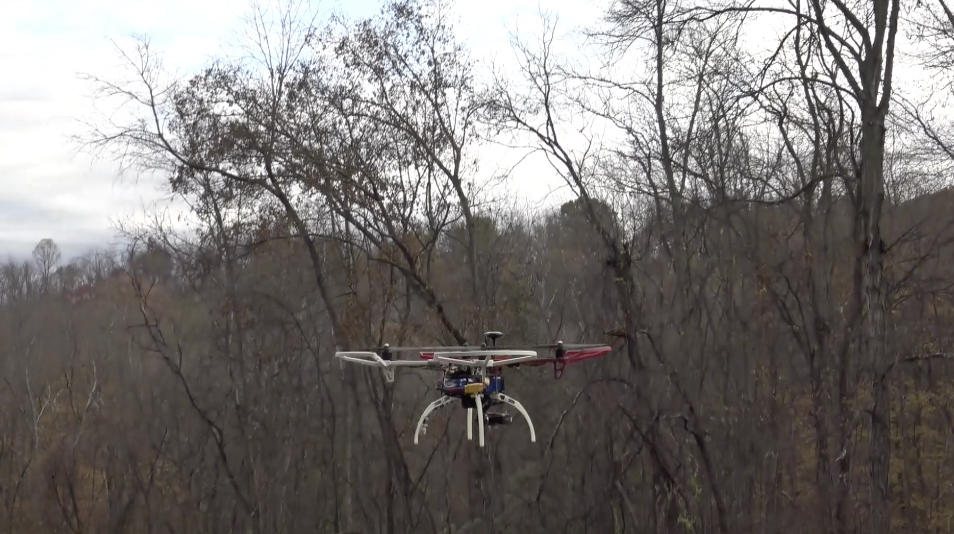
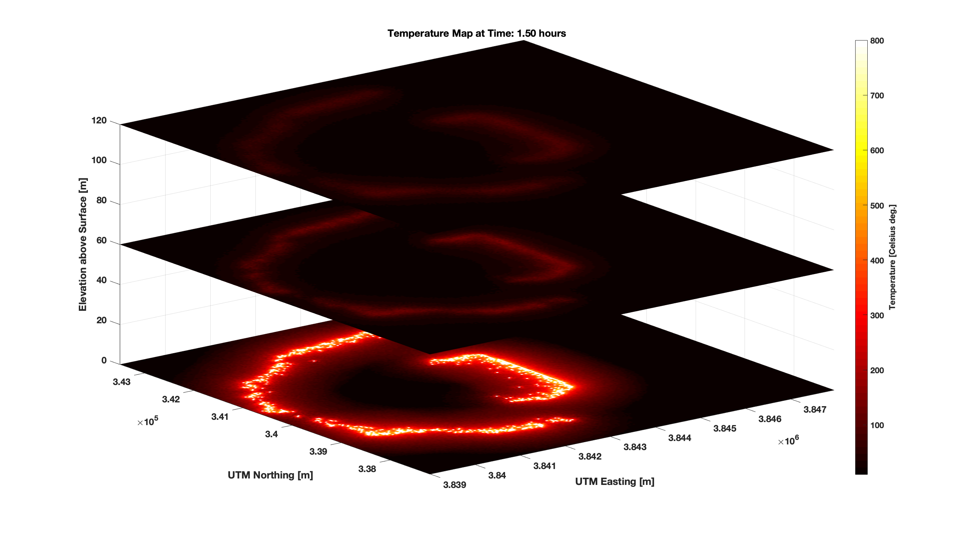
Research Plan: Challenges and Methods (1/3)
Environmental Situational Awareness
Obstacles and Loads
Challenges
Dense hard obstacles and intangible damage contours;
Probabilistic boundaries
Damage function modeling
Methods
Multi-source fusion using principles of evidential reasoning
Chance-constrained modeling
Unsupervised cluster learning to maximize flight space

Slide 12
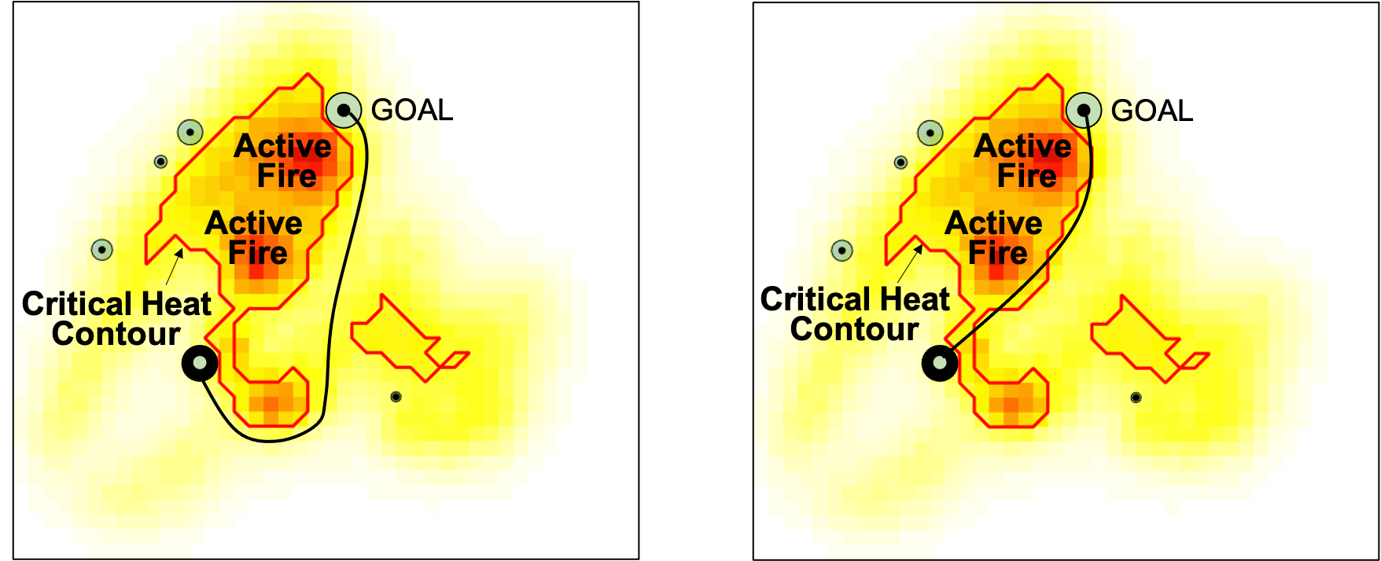
Research Plan: Challenges and Methods (2/3)
2. Path Planning
Challenges
Poorly understood dynamic obstacles in the environment
Intangible obstacles that inflict a rate of damage
Resulting resource chance constrained trajectory planning is NP hard
Methods
Sampling based transcription of RCC (resource chance constraints)
Novel graph search with backtracking to handle path-dependent integral (path loading) constraints
No Risk
Assumed Risk
Deterministic version of path dependent loading constraint
MEDIA REMOVED

Slide 13
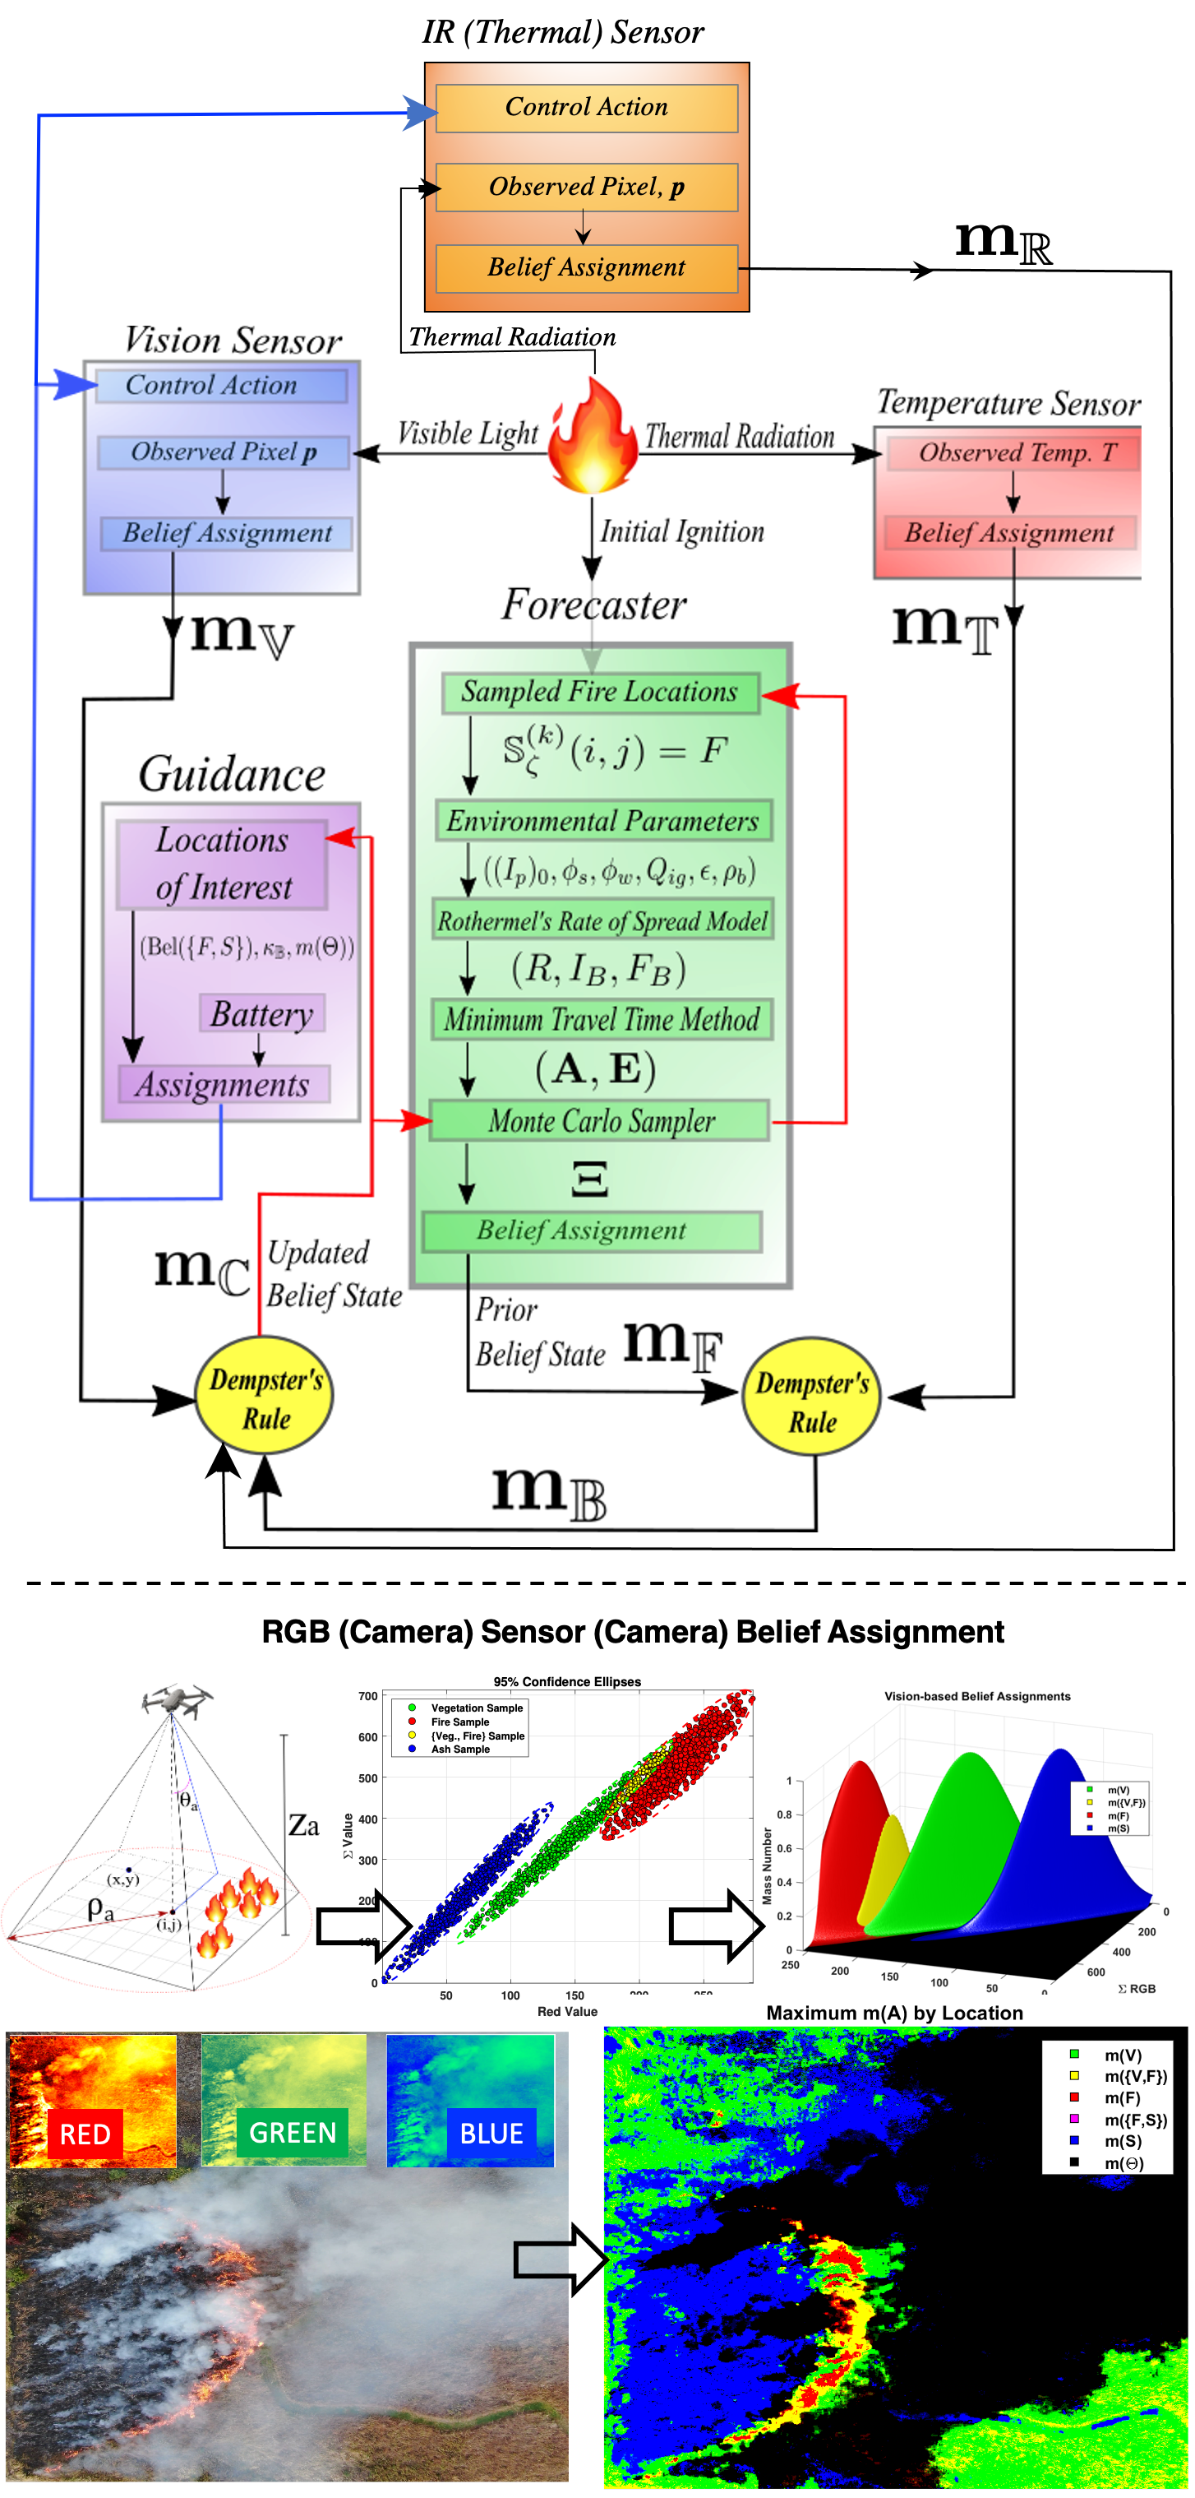
Research Plan: Challenges and Methods (3/3)
3. Evidential Information Fusion
Challenges
An adverse environment is typified by high incidence of poor priors (in the Bayesian sense),
Body of knowledge is slim: epistemic uncertainty is high
Trust in sensor data is weak and sensor conflict is common.
Methods
Empirical belief function construction (trial and error)
Unsupervised closed-loop learning of optimal indicators based on quantities of interest
Mission evaluation and realignment
MEDIA REMOVED

Slide 14
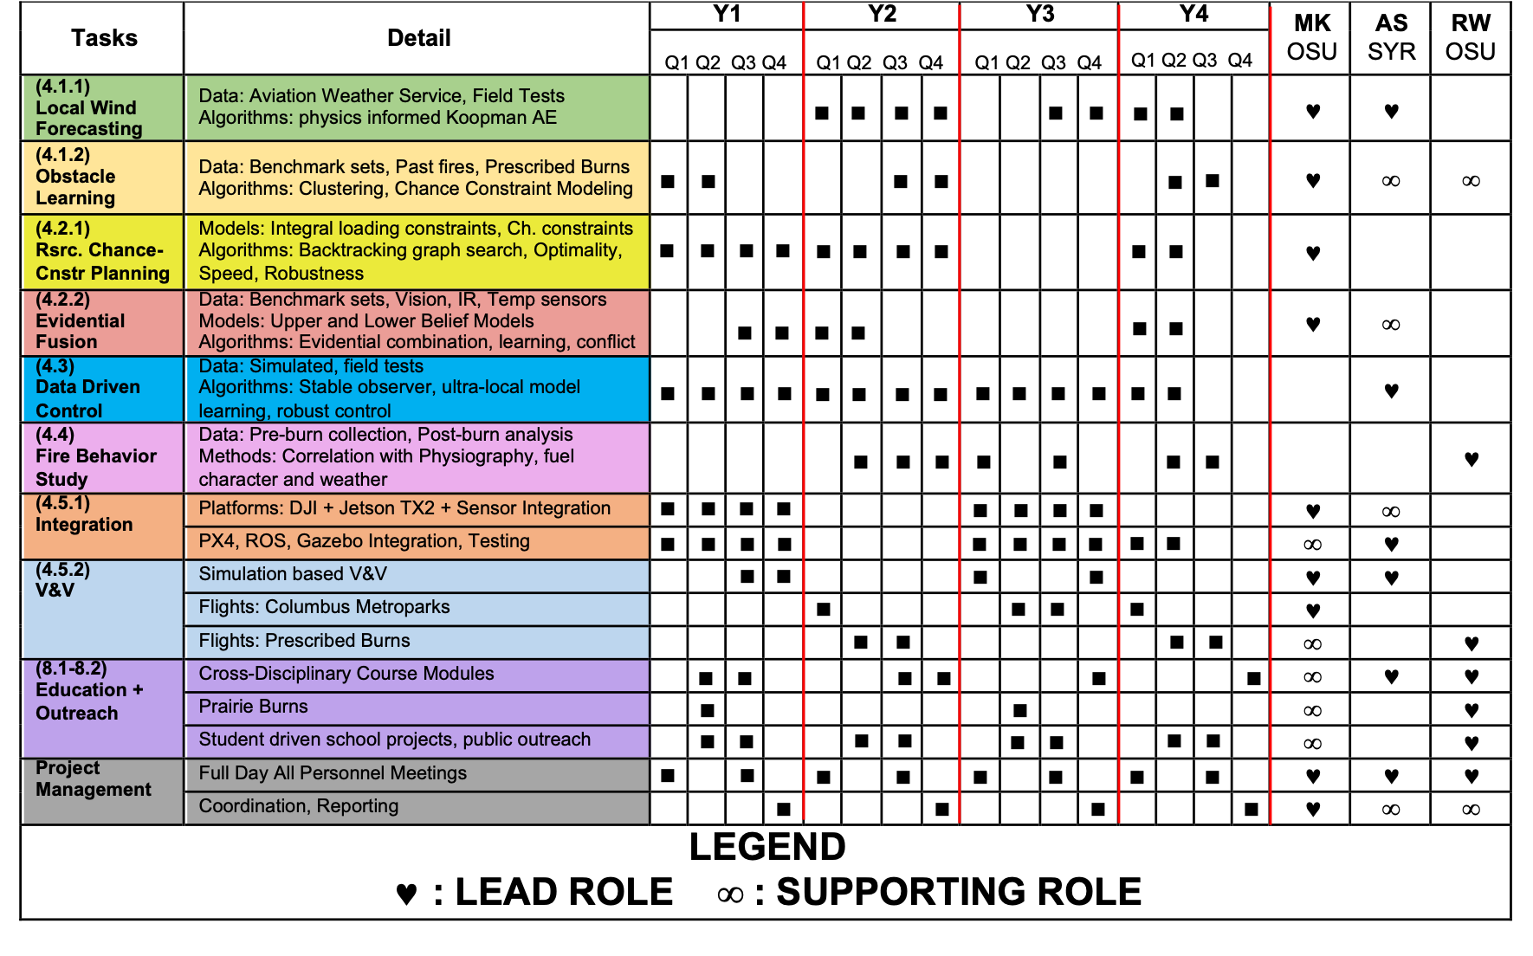
Research Plan: Tech Leads

